Slide 1
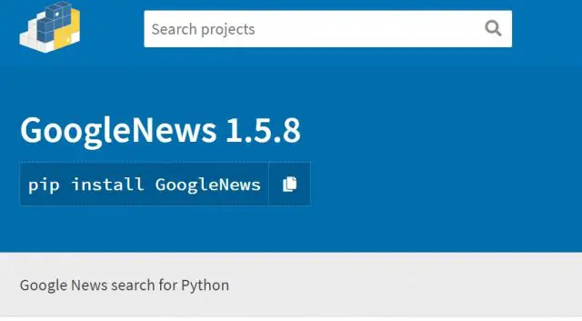
NLP Sentiment Analysis for Covid-19 News using Google News API
Dataset: live google news api
Presented by
Manisha Tak
31031421025

Slide 2

Problem Statement
This is a project where we use live google news api, to fetch the latest Covid-19 news. This project helps us know if the news is positive, negative, neutral based on the description of the news.
We can use this to determine the sentiments of the news. This code is used to help users know the latest news on COVID-19.

Slide 3
Tokenization
Removing HTML tags
Stop words Removal
Lemmatization
Parts of Speech (POS)
Data Visualization
Data Preprocessing
Techniques Used to Resolve Problem

Slide 4
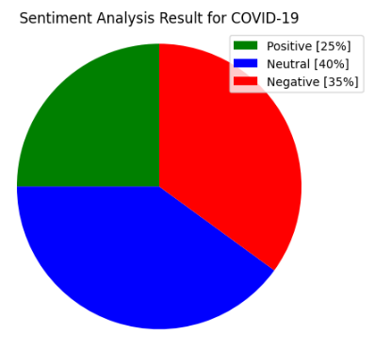
Accuracy

Slide 5
Conclusion and Further Scope
Google News: It is used to scrape news from the Google news📰 platform.
The coronavirus disease continues to spread across the world following a trajectory that is difficult to predict. The health, humanitarian and socio-economic policies adopted by countries will determine the speed and strength of the recovery.
This code is used to help users know the latest news on COVID-19.
Disclaimer:
The material in this Project is purely educational and should not be taken as professional advice. The idea of this simple code is just to know the latest news from Google News api library and to demonstrate the possibilities using Semantic Analysis.

Slide 6
Thank you Link to GitHub - https://github.com/manishatak/sentiment-analysis-on-covid-19-google-news

